Slide 1
Data Mining: Concepts and Techniques (3rd ed.) — Chapter 4 —
Jiawei Han, Micheline Kamber, and Jian Pei
University of Illinois at Urbana-Champaign &
Simon Fraser University
©2011 Han, Kamber & Pei. All rights reserved.
‹#›
‹#›
Notes:
‹#›
‹#›

Slide 2
Chapter 4: Data Warehousing and On-line Analytical Processing
Data Warehouse: Basic Concepts
Data Warehouse Modeling: Data Cube and OLAP
Data Warehouse Design and Usage
Data Warehouse Implementation
Data Generalization by Attribute-Oriented Induction
Summary
‹#›
Notes:
‹#›

Slide 3
What is a Data Warehouse?
Defined in many different ways, but not rigorously.
A decision support database that is maintained separately from the organization’s operational database
Support information processing by providing a solid platform of consolidated, historical data for analysis.
“A data warehouse is a subject-oriented, integrated, time-variant, and nonvolatile collection of data in support of management’s decision-making process.”—W. H. Inmon
Data warehousing:
The process of constructing and using data warehouses
‹#›
Notes:
‹#›

Slide 4
Data Warehouse—Subject-Oriented
Organized around major subjects, such as customer, product, sales
Focusing on the modeling and analysis of data for decision makers, not on daily operations or transaction processing
Provide a simple and concise view around particular subject issues by excluding data that are not useful in the decision support process
‹#›
Notes:
‹#›

Slide 5
Data Warehouse—Integrated
Constructed by integrating multiple, heterogeneous data sources
relational databases, flat files, on-line transaction records
Data cleaning and data integration techniques are applied.
Ensure consistency in naming conventions, encoding structures, attribute measures, etc. among different data sources
E.g., Hotel price: currency, tax, breakfast covered, etc.
When data is moved to the warehouse, it is converted.
‹#›
Notes:
‹#›

Slide 6
Data Warehouse—Time Variant
The time horizon for the data warehouse is significantly longer than that of operational systems
Operational database: current value data
Data warehouse data: provide information from a historical perspective (e.g., past 5-10 years)
Every key structure in the data warehouse
Contains an element of time, explicitly or implicitly
But the key of operational data may or may not contain “time element”
‹#›
Notes:
‹#›

Slide 7
Data Warehouse—Nonvolatile
A physically separate store of data transformed from the operational environment
Operational update of data does not occur in the data warehouse environment
Does not require transaction processing, recovery, and concurrency control mechanisms
Requires only two operations in data accessing:
initial loading of data and access of data
‹#›
Notes:
‹#›

Slide 8
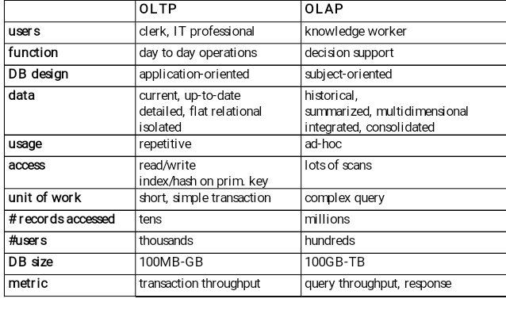
OLTP vs. OLAP
‹#›
Notes:
‹#›

Slide 9
Why a Separate Data Warehouse?
High performance for both systems
DBMS— tuned for OLTP: access methods, indexing, concurrency control, recovery
Warehouse—tuned for OLAP: complex OLAP queries, multidimensional view, consolidation
Different functions and different data:
missing data: Decision support requires historical data which operational DBs do not typically maintain
data consolidation: DS requires consolidation (aggregation, summarization) of data from heterogeneous sources
data quality: different sources typically use inconsistent data representations, codes and formats which have to be reconciled
Note: There are more and more systems which perform OLAP analysis directly on relational databases
‹#›
Notes:
‹#›

Slide 10
Data Warehouse: A Multi-Tiered Architecture
Monitor
&
Integrator
OLAP Server
Other
sources
Metadata
Analysis
Query
Reports
Data mining
Operational
DBs
Extract
Transform
Load
Refresh
Data
Warehouse
Serve
Data Marts
Data Sources
Data Storage
OLAP Engine
Front-End Tools
‹#›
Notes:
‹#›

Slide 11
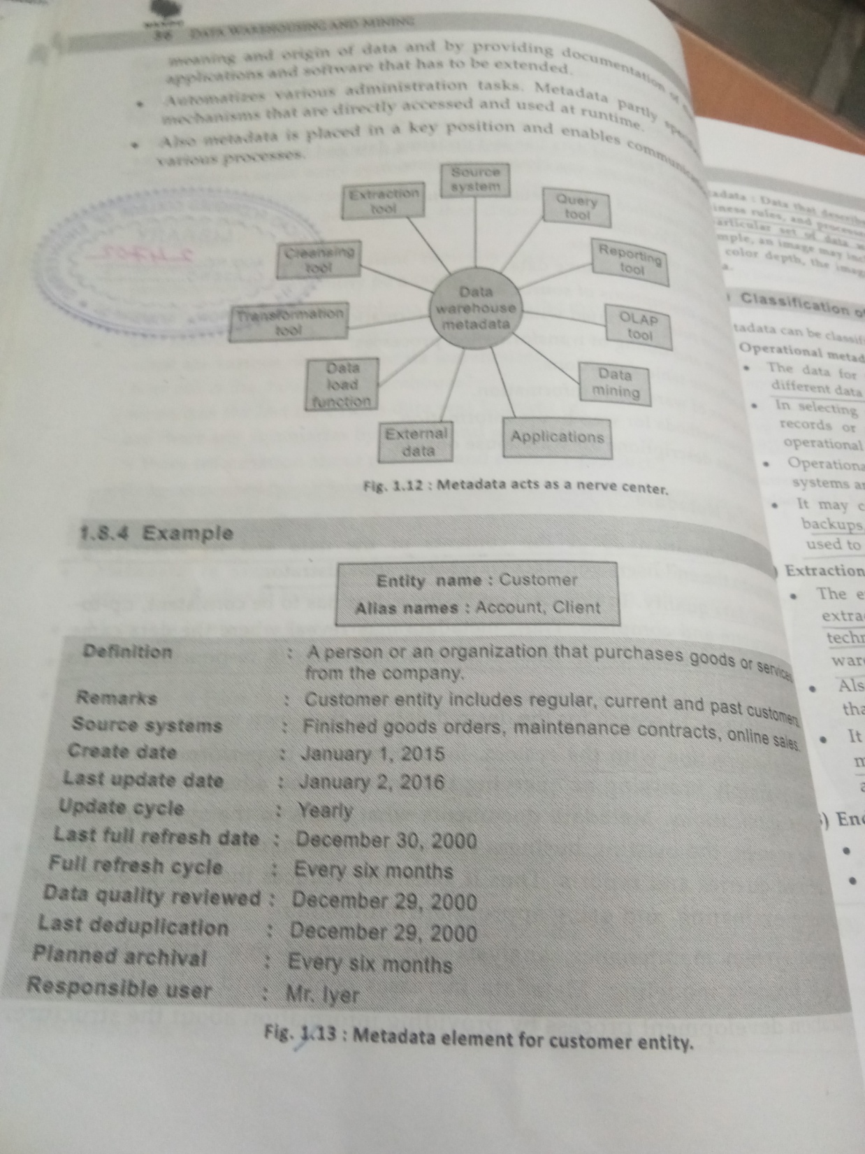

Slide 12
Metadata Repository
Meta data is the data defining warehouse objects. It stores:
Description of the structure of the data warehouse
schema, view, dimensions, hierarchies, derived data defn, data mart locations and contents
Classification -Operational meta-data, extraction and transformation meta data, end user meta data
Operational meta-data
data lineage (history of migrated data and transformation path), currency of data (active, archived, or purged), monitoring information (warehouse usage statistics, error reports, audit trails)
The algorithms used for summarization
The mapping from operational environment to the data warehouse
Data related to system performance
warehouse schema, view and derived data definitions
Business data
business terms and definitions, ownership of data, charging policies
‹#›
Notes:
‹#›

Slide 13
Different types of Architecture
Single layer Architecture- Middleware techlogoly
Minimize the amount of data storage-no separate store for DWH
Performance is the issue
2-T Architecture –
Enterprise server – client
3-T Architecture
Enterprise server –departmental server- client
DWH server-OLAP server-Client
*
Data Mining: Concepts and Techniques
‹#›

Slide 14
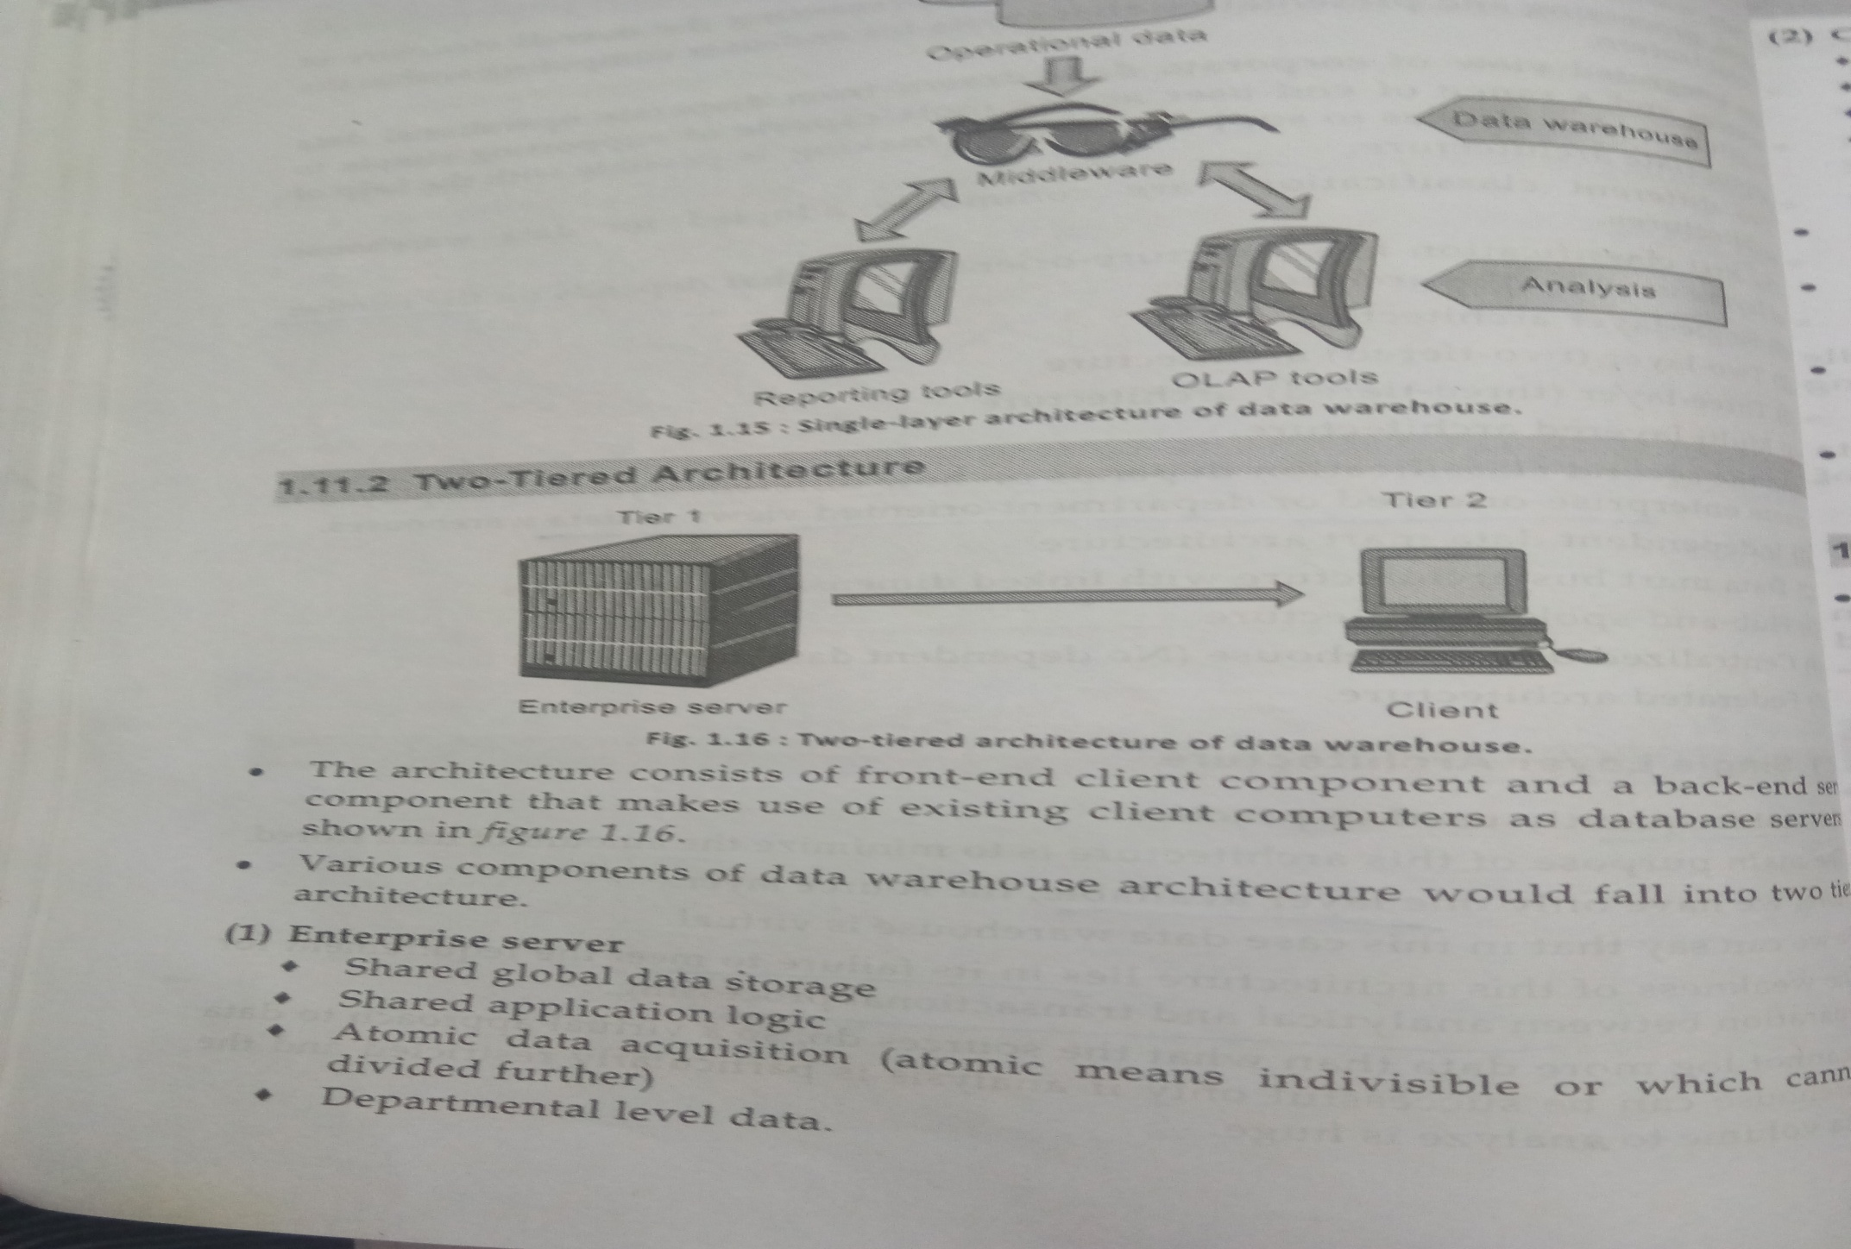
*
Data Mining: Concepts and Techniques
‹#›

Slide 15
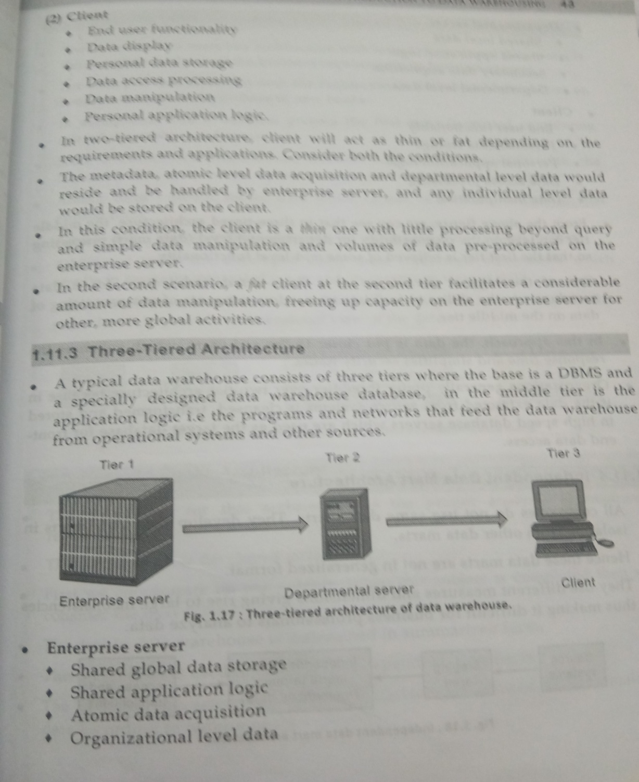
Departmental server
Shared local data
Shred application logic
Departmental level logic
Client
GUI
REPORTING TOOLS
OLAP TOOLS
*
Data Mining: Concepts and Techniques
‹#›

Slide 16
Three Data Warehouse Models
Enterprise warehouse
Data Mart
Virtual warehouse
Enterprise warehouse
Subject-collects all of the information about subjects spanning the entire organization
Scope- entire organization
Data-summarized data –GB-TB
Implemented by- mainframe, super servers or II Arch.
‹#›
Notes:
‹#›

Slide 17
Three Data Warehouse Models
Data Mart
a subset of corporate-wide data –departmental data
Scope – for a specific groups of users.
Its scope is confined to specific, selected groups, such as marketing data mart
Independent –sourced dircted from EDWH
vs. dependent -directly from operational system
Implemented low cost departmental servers-unix/linux/windows based
Virtual warehouse
A set of views over operational databases
Only some of the possible summary views may be materialized
‹#›
Notes:
‹#›

Slide 18
Extraction, Transformation, and Loading (ETL)
Data extraction
get data from multiple, heterogeneous, and external sources
Data cleaning
detect errors in the data and rectify them when possible
Data transformation
convert data from legacy or host format to warehouse format
Load
sort, summarize, consolidate, compute views, check integrity, and build indicies and partitions
Refresh
propagate the updates from the data sources to the warehouse
‹#›
Notes:
‹#›

Slide 19
Chapter 4: Data Warehousing and On-line Analytical Processing
Data Warehouse: Basic Concepts
Data Warehouse Modeling: Data Cube and OLAP
Data Warehouse Design and Usage
Data Warehouse Implementation
Data Generalization by Attribute-Oriented Induction
Summary
‹#›
Notes:
‹#›

Slide 20
From Tables and Spreadsheets to Data Cubes
A data warehouse is based on a multidimensional data model which views data in the form of a data cube
A data cube, such as sales, allows data to be modeled and viewed in multiple dimensions
Dimension tables,
Dimensions are entities w.r.t. organization wants to keep record.
such as item (item_name, brand, type), or time(day, week, month, quarter, year)
Fact table
Fact-quantity which organization wants to analyze, to find relationship/association –numerical mesures
contains measures (such as dollars_sold) and keys to each of the related dimension tables
‹#›
Notes:
‹#›

Slide 21
Cube: A Lattice of Cuboids
all
0-D (apex) cuboid
time
item
location
supplier
1-D cuboids
time,location
item,location
location,supplier
time,item
2-D cuboids
time,supplier
item,supplier
time,location,supplier
3-D cuboids
time,item,location
time,item,supplier
item,location,supplier
4-D (base) cuboid
time, item, location, supplier
‹#›
Notes:
‹#›

Slide 22
Multidimensional Data
Sales volume as a function of product, month, and region
Dimensions: Product, Location, Time
Hierarchical summarization paths
Region
Industry Region Year
Category Country Quarter
Product City Month Week
Office Day
Product
Month
‹#›
Notes:
‹#›

Slide 23
Conceptual Modeling of Data Warehouses
Modeling data warehouses: dimensions & measures
Star schema: A fact table in the middle connected to a set of dimension tables
Snowflake schema: A refinement of star schema where some dimensional hierarchy is normalized into a set of smaller dimension tables, forming a shape similar to snowflake
Fact constellations: Multiple fact tables share dimension tables, viewed as a collection of stars, therefore called galaxy schema or fact constellation
‹#›
Notes:
‹#›

Slide 24
Example of Star Schema
time
time_key
day
day_of_the_week
month
quarter
year
item
item_key
item_name
brand
type
supplier_type
Sales Fact Table
time_key
item_key
branch_key
branch
location
location_key
branch_key
branch_name
branch_type
location_key
street
city
state_or_province
country
units_sold
dollars_sold
avg_sales
Measures
‹#›
Notes:
‹#›

Slide 25
Example of Snowflake Schema
time
item
time_key
day
day_of_the_week
month
quarter
year
item_key
item_name
brand
type
supplier_key
supplier
Sales Fact Table
supplier_key
supplier_type
time_key
item_key
branch_key
branch
location
location_key
location_key
street
city_key
branch_key
branch_name
branch_type
units_sold
dollars_sold
city
city_key
city
state_or_province
country
avg_sales
Measures
‹#›
Notes:
‹#›

Slide 26
Example of Fact Constellation
time
time_key
day
day_of_the_week
month
quarter
year
item
Shipping Fact Table
item_key
item_name
brand
type
supplier_type
Sales Fact Table
time_key
time_key
item_key
shipper_key
item_key
branch_key
from_location
branch
location_key
location
to_location
branch_key
branch_name
branch_type
units_sold
location_key
street
city
province_or_state
country
dollars_cost
dollars_sold
units_shipped
avg_sales
shipper
Measures
shipper_key
shipper_name
location_key
shipper_type
‹#›
Notes:
‹#›

Slide 27
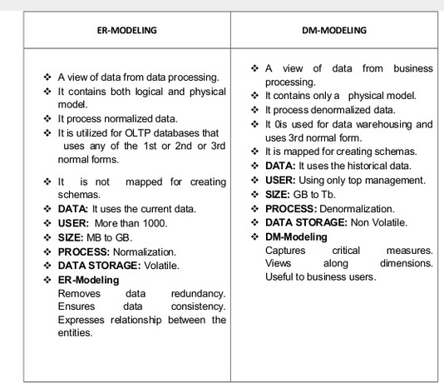
*
Data Mining: Concepts and Techniques
‹#›

Slide 28
A Concept Hierarchy: Dimension (location)
all
all
region
Europe
...
North_America
country
Germany
...
Spain
Canada
...
Mexico
city
Frankfurt
...
Vancouver
...
Toronto
office
L. Chan
...
M. Wind
‹#›
Notes:
‹#›

Slide 29
Data Cube Measures: Three Categories
Distributive: if the result derived by applying the function to n aggregate values is the same as that derived by applying the function on all the data without partitioning
E.g., count(), sum(), min(), max()
Algebraic: if it can be computed by an algebraic function with M arguments (where M is a bounded integer), each of which is obtained by applying a distributive aggregate function
E.g., avg(), min_N(), standard_deviation()
Holistic: if there is no constant bound on the storage size needed to describe a subaggregate.
E.g., median(), mode(), rank()
‹#›
Notes:
‹#›

Slide 30
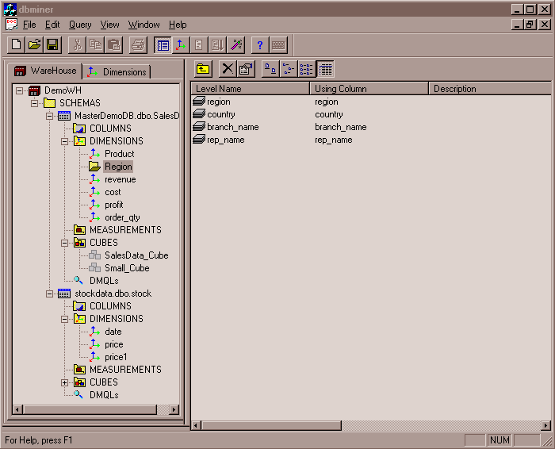
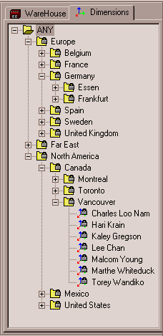
View of Warehouses and Hierarchies
Specification of hierarchies
Schema hierarchy
day < {month < quarter; week} < year
Set_grouping hierarchy
{1..10} < inexpensive
‹#›
Notes:
‹#›

Slide 31
Multidimensional Data
Sales volume as a function of product, month, and region
Dimensions: Product, Location, Time
Hierarchical summarization paths
Region
Industry Region Year
Category Country Quarter
Product City Month Week
Office Day
Product
Month
‹#›
Notes:
‹#›

Slide 32
A Sample Data Cube
Date
Total annual sales
of TVs in U.S.A.
1Qtr
2Qtr
3Qtr
4Qtr
sum
Product
TV
PC
U.S.A
VCR
sum
Canada
Country
Mexico
sum
All, All, All
‹#›
Notes:
‹#›

Slide 33
Cuboids Corresponding to the Cube
all
0-D (apex) cuboid
product
date
country
1-D cuboids
product,date
product,country
date, country
2-D cuboids
3-D (base) cuboid
product, date, country
‹#›
Notes:
‹#›

Slide 34
Typical OLAP Operations
Roll up (drill-up): summarize data
by climbing up hierarchy or by dimension reduction
Drill down (roll down): reverse of roll-up
from higher level summary to lower level summary or detailed data, or introducing new dimensions
Slice and dice: project and select
Pivot (rotate):
reorient the cube, visualization, 3D to series of 2D planes
Other operations
drill across: involving (across) more than one fact table
drill through: through the bottom level of the cube to its back-end relational tables (using SQL)
‹#›
Notes:
‹#›

Slide 35
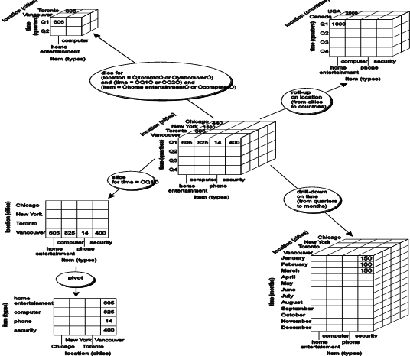
Fig. 3.10 Typical OLAP Operations
‹#›
Notes:
‹#›

Slide 36
A Star-Net Query Model
Customer Orders
Shipping Method
Customer
CONTRACTS
AIR-EXPRESS
ORDER
TRUCK
PRODUCT LINE
Time
Product
ANNUALY
QTRLY
DAILY
PRODUCT ITEM
PRODUCT GROUP
CITY
SALES PERSON
COUNTRY
DISTRICT
REGION
DIVISION
Location
Each circle is called a footprint
Promotion
Organization
‹#›
Notes:
‹#›

Slide 37
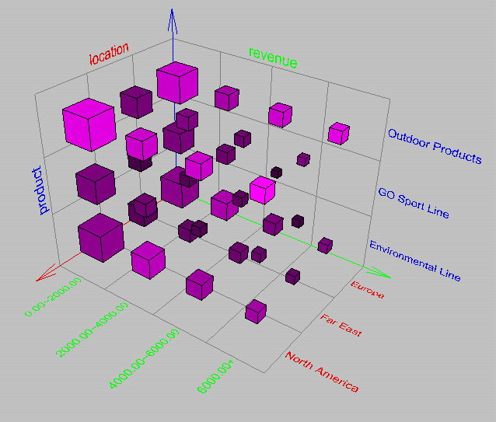
Browsing a Data Cube
Visualization
OLAP capabilities
Interactive manipulation
‹#›
Notes:
‹#›

Slide 38
Chapter 4: Data Warehousing and On-line Analytical Processing
Data Warehouse: Basic Concepts
Data Warehouse Modeling: Data Cube and OLAP
Data Warehouse Design and Usage
Data Warehouse Implementation
Data Generalization by Attribute-Oriented Induction
Summary
‹#›
Notes:
‹#›

Slide 39
Design of Data Warehouse: A Business Analysis Framework
Four views regarding the design of a data warehouse
Top-down view
allows selection of the relevant information necessary for the data warehouse
Data source view
exposes the information being captured, stored, and managed by operational systems
Data warehouse view
consists of fact tables and dimension tables
Business query view
sees the perspectives of data in the warehouse from the view of end-user
‹#›
Notes:
‹#›

Slide 40
Data Warehouse Design Process
Top-down, bottom-up approaches or a combination of both
Top-down: Starts with overall design and planning (mature)
Bottom-up: Starts with experiments and prototypes (rapid)
From software engineering point of view
Waterfall: structured and systematic analysis at each step before proceeding to the next
Spiral: rapid generation of increasingly functional systems, short turn around time, quick turn around
Typical data warehouse design process
Choose a business process to model, e.g., orders, invoices, etc.
Choose the grain (atomic level of data) of the business process
Choose the dimensions that will apply to each fact table record
Choose the measure that will populate each fact table record
‹#›
Notes:
‹#›

Slide 41
Data Warehouse Development: A Recommended Approach
Multi-Tier Data Warehouse
Distributed Data Marts
Enterprise Data Warehouse
Data Mart
Data Mart
Model refinement
Model refinement
Define a high-level corporate data model
‹#›
Notes:
‹#›

Slide 42
Data Warehouse Usage
Three kinds of data warehouse applications
Information processing
supports querying, basic statistical analysis, and reporting using crosstabs, tables, charts and graphs
Analytical processing
multidimensional analysis of data warehouse data
supports basic OLAP operations, slice-dice, drilling, pivoting
Data mining
knowledge discovery from hidden patterns
supports associations, constructing analytical models, performing classification and prediction, and presenting the mining results using visualization tools
‹#›
Notes:
‹#›

Slide 43
From On-Line Analytical Processing (OLAP) to On Line Analytical Mining (OLAM)
Why online analytical mining?
High quality of data in data warehouses
DW contains integrated, consistent, cleaned data
Available information processing structure surrounding data warehouses
ODBC, OLEDB, Web accessing, service facilities, reporting and OLAP tools
OLAP-based exploratory data analysis
Mining with drilling, dicing, pivoting, etc.
On-line selection of data mining functions
Integration and swapping of multiple mining functions, algorithms, and tasks
‹#›
Notes:
‹#›

Slide 44
Chapter 4: Data Warehousing and On-line Analytical Processing
Data Warehouse: Basic Concepts
Data Warehouse Modeling: Data Cube and OLAP
Data Warehouse Design and Usage
Data Warehouse Implementation
Data Generalization by Attribute-Oriented Induction
Summary
‹#›
Notes:
‹#›

Slide 45
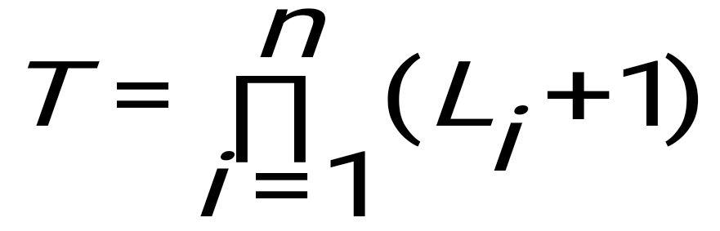
Efficient Data Cube Computation
Data cube can be viewed as a lattice of cuboids
The bottom-most cuboid is the base cuboid
The top-most cuboid (apex) contains only one cell
How many cuboids in an n-dimensional cube with L levels?
n- no. of dimensions, Li – no of levels in ith dimension
Materialization of data cube
Materialize every (cuboid) (full materialization), none (no materialization), or some (partial materialization)
Selection of which cuboids to materialize
Based on size, sharing, access frequency, etc.
‹#›
Notes:
‹#›

Slide 46
The “Compute Cube” Operator
Cube definition and computation in DMQL
define cube sales [item, city, year]: sum (sales_in_dollars)
compute cube sales
Transform it into a SQL-like language (with a new operator cube by, introduced by Gray et al.’96)
SELECT item, city, year, SUM (amount)
FROM SALES
CUBE BY item, city, year
Need compute the following Group-Bys
(date, product, customer),
(date,product),(date, customer), (product, customer),
(date), (product), (customer)
()
()
(city)
(item)
(year)
(city, item)
(city, year)
(item, year)
(city, item, year)
‹#›
Notes:
‹#›

Slide 47
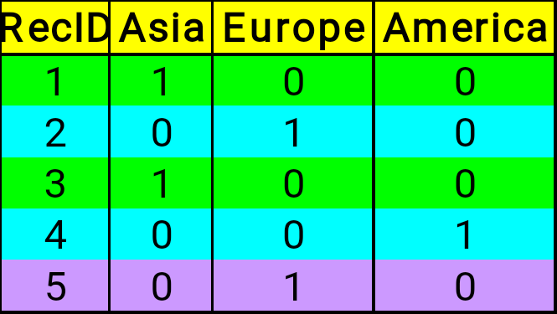
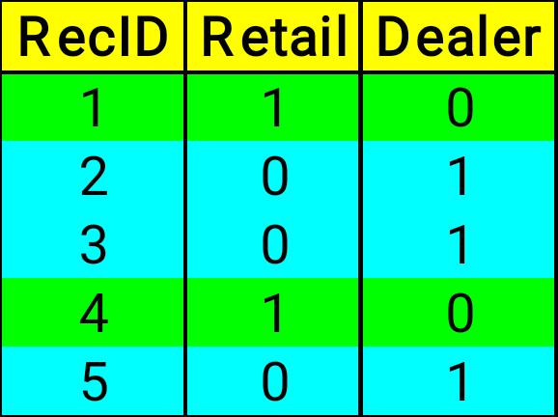
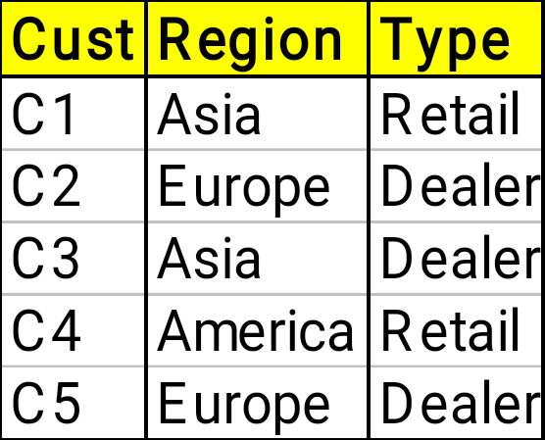
Indexing OLAP Data: Bitmap Index
Index on a particular column
Each value in the column has a bit vector: bit-op is fast
The length of the bit vector: # of records in the base table
The i-th bit is set if the i-th row of the base table has the value for the indexed column
not suitable for high cardinality domains
A recent bit compression technique, Word-Aligned Hybrid (WAH), makes it work for high cardinality domain as well [Wu, et al. TODS’06]
Base table
Index on Region
Index on Type
‹#›
Notes:
‹#›

Slide 48
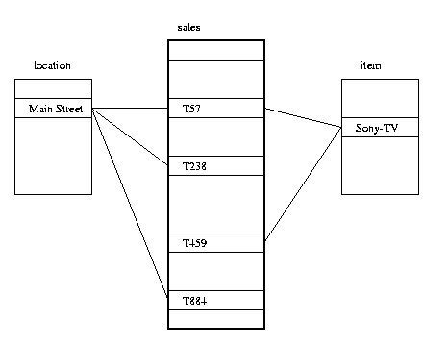
Indexing OLAP Data: Join Indices
Join index: JI(R-id, S-id) where R (R-id, …)  S (S-id, …)
Traditional indices map the values to a list of record ids
It materializes relational join in JI file and speeds up relational join
In data warehouses, join index relates the values of the dimensions of a start schema to rows in the fact table.
E.g. fact table: Sales and two dimensions city and product
A join index on city maintains for each distinct city a list of R-IDs of the tuples recording the Sales in the city
Join indices can span multiple dimensions
‹#›
Notes:
‹#›

Slide 49
Efficient Processing OLAP Queries
Determine which operations should be performed on the available cuboids
Transform drill, roll, etc. into corresponding SQL and/or OLAP operations, e.g., dice = selection + projection
Determine which materialized cuboid(s) should be selected for OLAP op.
Let the query to be processed be on {brand, province_or_state} with the condition “year = 2004”, and there are 4 materialized cuboids available:
1) {year, item_name, city}
2) {year, brand, country}
3) {year, brand, province_or_state}
4) {item_name, province_or_state} where year = 2004
Which should be selected to process the query?
Explore indexing structures and compressed vs. dense array structs in MOLAP
‹#›
Notes:
‹#›

Slide 50
OLAP Server Architectures
Relational OLAP (ROLAP)
Use relational or extended-relational DBMS to store and manage warehouse data and OLAP middle ware
Include optimization of DBMS backend, implementation of aggregation navigation logic, and additional tools and services
Greater scalability
Multidimensional OLAP (MOLAP)
Sparse array-based multidimensional storage engine
Fast indexing to pre-computed summarized data
Hybrid OLAP (HOLAP) (e.g., Microsoft SQLServer)
Flexibility, e.g., low level: relational, high-level: array
Specialized SQL servers (e.g., Redbricks)
Specialized support for SQL queries over star/snowflake schemas
‹#›
Notes:
‹#›

Slide 51
Chapter 4: Data Warehousing and On-line Analytical Processing
Data Warehouse: Basic Concepts
Data Warehouse Modeling: Data Cube and OLAP
Data Warehouse Design and Usage
Data Warehouse Implementation
Data Generalization by Attribute-Oriented Induction
Summary
‹#›
Notes:
‹#›

Slide 52
Attribute-Oriented Induction
Proposed in 1989 (KDD ‘89 workshop)
Not confined to categorical data nor particular measures
How it is done?
Collect the task-relevant data (initial relation) using a relational database query
Perform generalization by attribute removal or attribute generalization
Apply aggregation by merging identical, generalized tuples and accumulating their respective counts
Interaction with users for knowledge presentation
‹#›
Notes:
‹#›

Slide 53
Attribute-Oriented Induction: An Example
Example: Describe general characteristics of graduate students in the University database
Step 1. Fetch relevant set of data using an SQL statement, e.g.,
Select * (i.e., name, gender, major, birth_place, birth_date, residence, phone#, gpa)
from student
where student_status in {“Msc”, “MBA”, “PhD” }
Step 2. Perform attribute-oriented induction
Step 3. Present results in generalized relation, cross-tab, or rule forms
‹#›
Notes:
‹#›

Slide 54
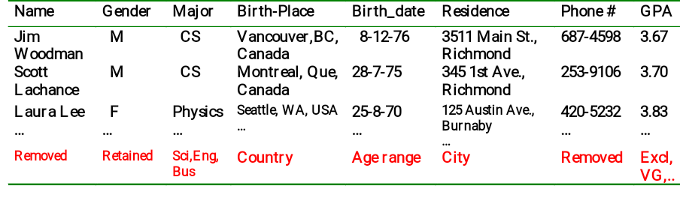
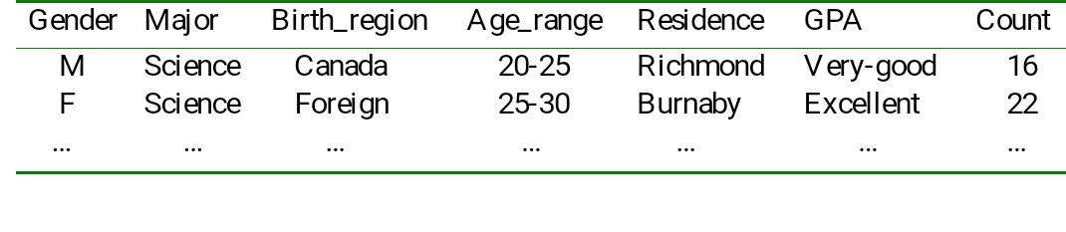
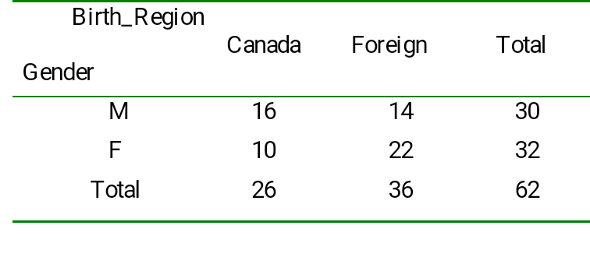
Class Characterization: An Example
Initial Relation
Prime Generalized Relation
‹#›
Notes:
‹#›

Slide 55
Basic Principles of Attribute-Oriented Induction
Data focusing: task-relevant data, including dimensions, and the result is the initial relation
Attribute-removal: remove attribute A if there is a large set of distinct values for A but (1) there is no generalization operator on A, or (2) A’s higher level concepts are expressed in terms of other attributes
Attribute-generalization: If there is a large set of distinct values for A, and there exists a set of generalization operators on A, then select an operator and generalize A
Attribute-threshold control: typical 2-8, specified/default
Generalized relation threshold control: control the final relation/rule size
‹#›
Notes:
‹#›

Slide 56
Attribute-Oriented Induction: Basic Algorithm
InitialRel: Query processing of task-relevant data, deriving the initial relation.
PreGen: Based on the analysis of the number of distinct values in each attribute, determine generalization plan for each attribute: removal? or how high to generalize?
PrimeGen: Based on the PreGen plan, perform generalization to the right level to derive a “prime generalized relation”, accumulating the counts.
Presentation: User interaction: (1) adjust levels by drilling, (2) pivoting, (3) mapping into rules, cross tabs, visualization presentations.
‹#›
Notes:
‹#›

Slide 57
Presentation of Generalized Results
Generalized relation:
Relations where some or all attributes are generalized, with counts or other aggregation values accumulated.
Cross tabulation:
Mapping results into cross tabulation form (similar to contingency tables).
Visualization techniques:
Pie charts, bar charts, curves, cubes, and other visual forms.
Quantitative characteristic rules:
Mapping generalized result into characteristic rules with quantitative information associated with it, e.g.,
‹#›
Notes:
‹#›

Slide 58
Mining Class Comparisons
Comparison: Comparing two or more classes
Method:
Partition the set of relevant data into the target class and the contrasting class(es)
Generalize both classes to the same high level concepts
Compare tuples with the same high level descriptions
Present for every tuple its description and two measures
support - distribution within single class
comparison - distribution between classes
Highlight the tuples with strong discriminant features
Relevance Analysis:
Find attributes (features) which best distinguish different classes
‹#›
Notes:
‹#›

Slide 59
Concept Description vs. Cube-Based OLAP
Similarity:
Data generalization
Presentation of data summarization at multiple levels of abstraction
Interactive drilling, pivoting, slicing and dicing
Differences:
OLAP has systematic preprocessing, query independent, and can drill down to rather low level
AOI has automated desired level allocation, and may perform dimension relevance analysis/ranking when there are many relevant dimensions
AOI works on the data which are not in relational forms
‹#›
Notes:
‹#›

Slide 60
Chapter 4: Data Warehousing and On-line Analytical Processing
Data Warehouse: Basic Concepts
Data Warehouse Modeling: Data Cube and OLAP
Data Warehouse Design and Usage
Data Warehouse Implementation
Data Generalization by Attribute-Oriented Induction
Summary
‹#›
Notes:
‹#›

Slide 61
VIDEOS TO WATCH
https://www.youtube.com/watch?v=O7JYornSvjI
https://www.youtube.com/watch?v=J326LIUrZM8
Around BI
*
Data Mining: Concepts and Techniques
‹#›

Slide 62
Summary
Data warehousing: A multi-dimensional model of a data warehouse
A data cube consists of dimensions & measures
Star schema, snowflake schema, fact constellations
OLAP operations: drilling, rolling, slicing, dicing and pivoting
Data Warehouse Architecture, Design, and Usage
Multi-tiered architecture
Business analysis design framework
Information processing, analytical processing, data mining, OLAM (Online Analytical Mining)
Implementation: Efficient computation of data cubes
Partial vs. full vs. no materialization
Indexing OALP data: Bitmap index and join index
OLAP query processing
OLAP servers: ROLAP, MOLAP, HOLAP
Data generalization: Attribute-oriented induction
‹#›
Notes:
‹#›

Slide 63
References (I)
S. Agarwal, R. Agrawal, P. M. Deshpande, A. Gupta, J. F. Naughton, R. Ramakrishnan, and S. Sarawagi. On the computation of multidimensional aggregates. VLDB’96
D. Agrawal, A. E. Abbadi, A. Singh, and T. Yurek. Efficient view maintenance in data warehouses. SIGMOD’97
R. Agrawal, A. Gupta, and S. Sarawagi. Modeling multidimensional databases. ICDE’97
S. Chaudhuri and U. Dayal. An overview of data warehousing and OLAP technology. ACM SIGMOD Record, 26:65-74, 1997
E. F. Codd, S. B. Codd, and C. T. Salley. Beyond decision support. Computer World, 27, July 1993.
J. Gray, et al. Data cube: A relational aggregation operator generalizing group-by, cross-tab and sub-totals. Data Mining and Knowledge Discovery, 1:29-54, 1997.
A. Gupta and I. S. Mumick. Materialized Views: Techniques, Implementations, and Applications. MIT Press, 1999.
J. Han. Towards on-line analytical mining in large databases. ACM SIGMOD Record, 27:97-107, 1998.
V. Harinarayan, A. Rajaraman, and J. D. Ullman. Implementing data cubes efficiently. SIGMOD’96
J. Hellerstein, P. Haas, and H. Wang. Online aggregation. SIGMOD'97
‹#›
Notes:
‹#›

Slide 64
References (II)
C. Imhoff, N. Galemmo, and J. G. Geiger. Mastering Data Warehouse Design: Relational and Dimensional Techniques. John Wiley, 2003
W. H. Inmon. Building the Data Warehouse. John Wiley, 1996
R. Kimball and M. Ross. The Data Warehouse Toolkit: The Complete Guide to Dimensional Modeling. 2ed. John Wiley, 2002
P. O’Neil and G. Graefe. Multi-table joins through bitmapped join indices. SIGMOD Record, 24:8–11, Sept. 1995.
P. O'Neil and D. Quass. Improved query performance with variant indexes. SIGMOD'97
Microsoft. OLEDB for OLAP programmer's reference version 1.0. In http://www.microsoft.com/data/oledb/olap, 1998
S. Sarawagi and M. Stonebraker. Efficient organization of large multidimensional arrays. ICDE'94
A. Shoshani. OLAP and statistical databases: Similarities and differences. PODS’00.
D. Srivastava, S. Dar, H. V. Jagadish, and A. V. Levy. Answering queries with aggregation using views. VLDB'96
P. Valduriez. Join indices. ACM Trans. Database Systems, 12:218-246, 1987.
J. Widom. Research problems in data warehousing. CIKM’95
K. Wu, E. Otoo, and A. Shoshani, Optimal Bitmap Indices with Efficient Compression, ACM Trans. on Database Systems (TODS), 31(1): 1-38, 2006
‹#›
Notes:
‹#›

Slide 65
Surplus Slides
‹#›
Notes:
‹#›

Slide 66
Compression of Bitmap Indices
Bitmap indexes must be compressed to reduce I/O costs and minimize CPU usage—majority of the bits are 0’s
Two compression schemes:
Byte-aligned Bitmap Code (BBC)
Word-Aligned Hybrid (WAH) code
Time and space required to operate on compressed bitmap is proportional to the total size of the bitmap
Optimal on attributes of low cardinality as well as those of high cardinality.
WAH out performs BBC by about a factor of two
‹#›
Notes:
‹#›
K. Wu, E. Otoo, and A. Shoshani, Bitmap Index Compression Optimality, VLDB’04
Need to digest and rewrite it using an example! See full abstract on slide towards end of file.

